Slide 1
The Perfect Cookie
Alyssa Ford, Spencer Hales, Eliza Campbell, Blake Olsen
AKA The Chicken Strips
Notes:
E

Slide 2
What is your perfect cookie
Notes:
E

Slide 3
How do temperature and ingredients affect the diameter of a chocolate chip cookie?
Notes:
E

Slide 4
Research Design
Two factor ANOVA
Factor 1: Temperature
Levels - chilled, room temperature
Factor 2: Ingredients
Levels - mixed, baking soda, baking powder
Experimental Unit: Each cookie
Notes:
E

Slide 5
Treatment # | Temperature | Ingredient
1 | Chilled | Mix
2 | Chilled | Soda
3 | Chilled | Powder
4 | Room Temp | Mix
5 | Room Temp | Soda
6 | Room Temp | Powder
Notes:
E

Slide 6
Expected Findings / Hypothesis
We expected the room temperature cookies with baking soda to be the biggest
Chilled cookies in the past have turned out smaller than room temperature so we were interested in seeing if there was a difference
Ho: There will be no difference in cookie diameter no matter what temperature the dough is or which ingredients are used
Ha: There is a difference in cookie diameter with at least one level of temperature or ingredient
Notes:
S

Slide 7
Preliminary Testing
To estimate our sample size….
power.anova.test(groups = 6, between.var = var(c(4, 5, 3, 6, 7, 5)), within.var = (3.5)^2, sig.level = .05, power = .80)
We got an answer of n = 16.6608 so we knew our sample would have 17 cookies in each group
Notes:
S

Slide 8
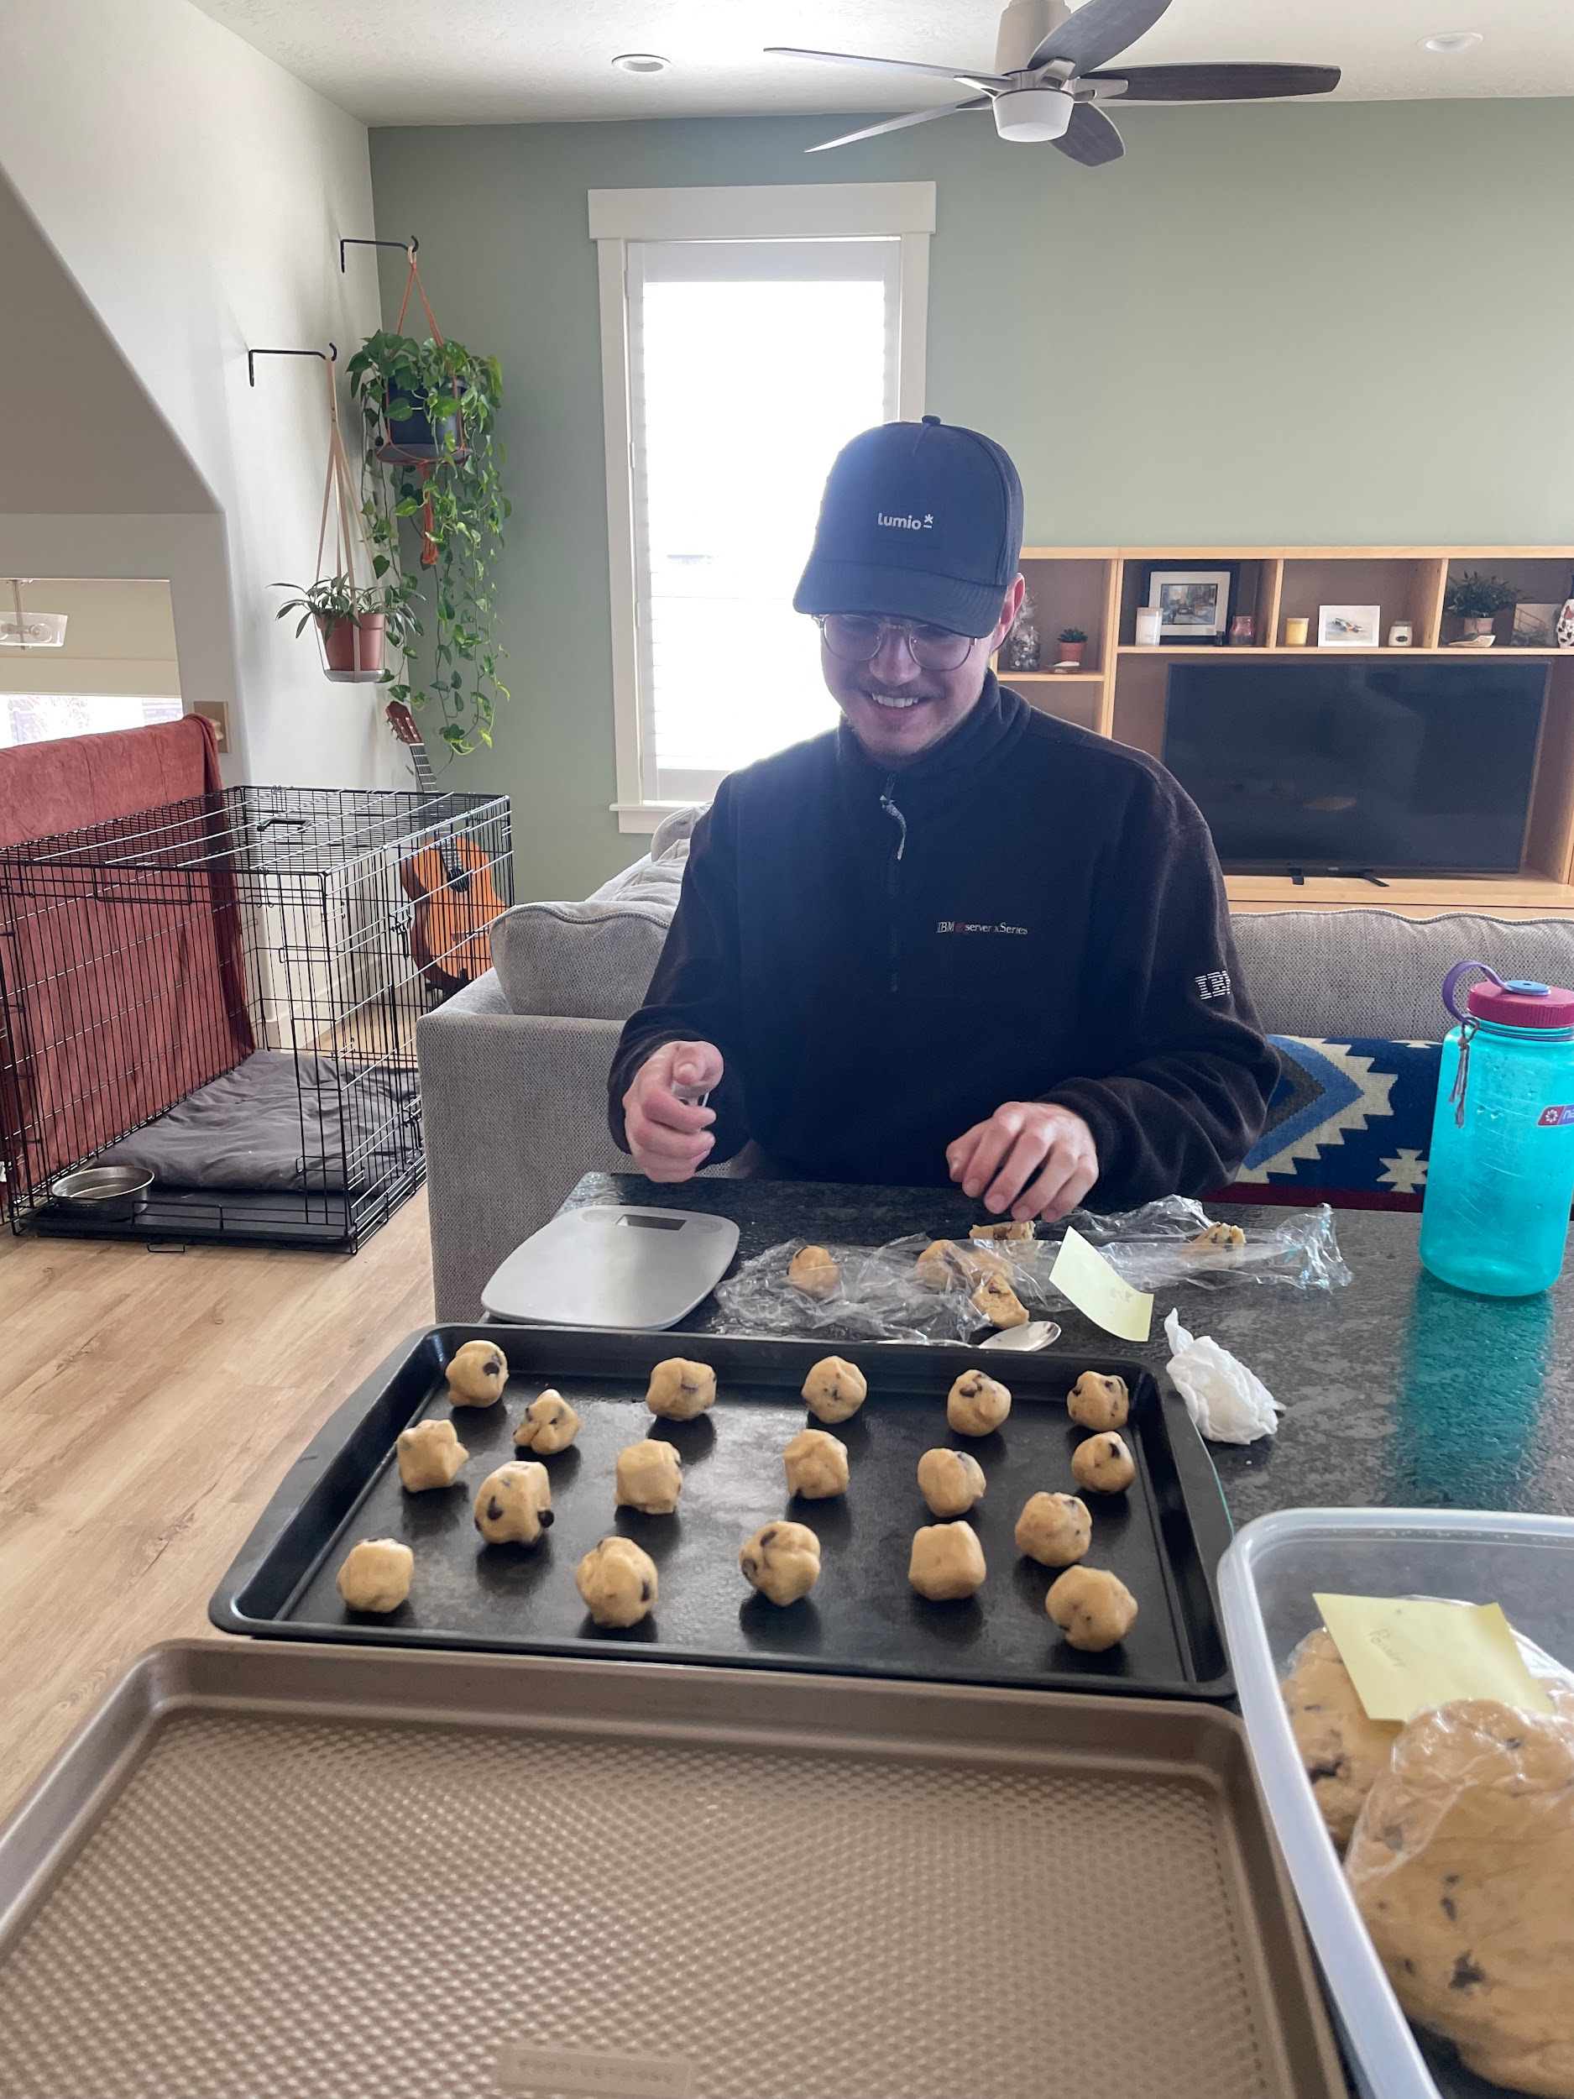
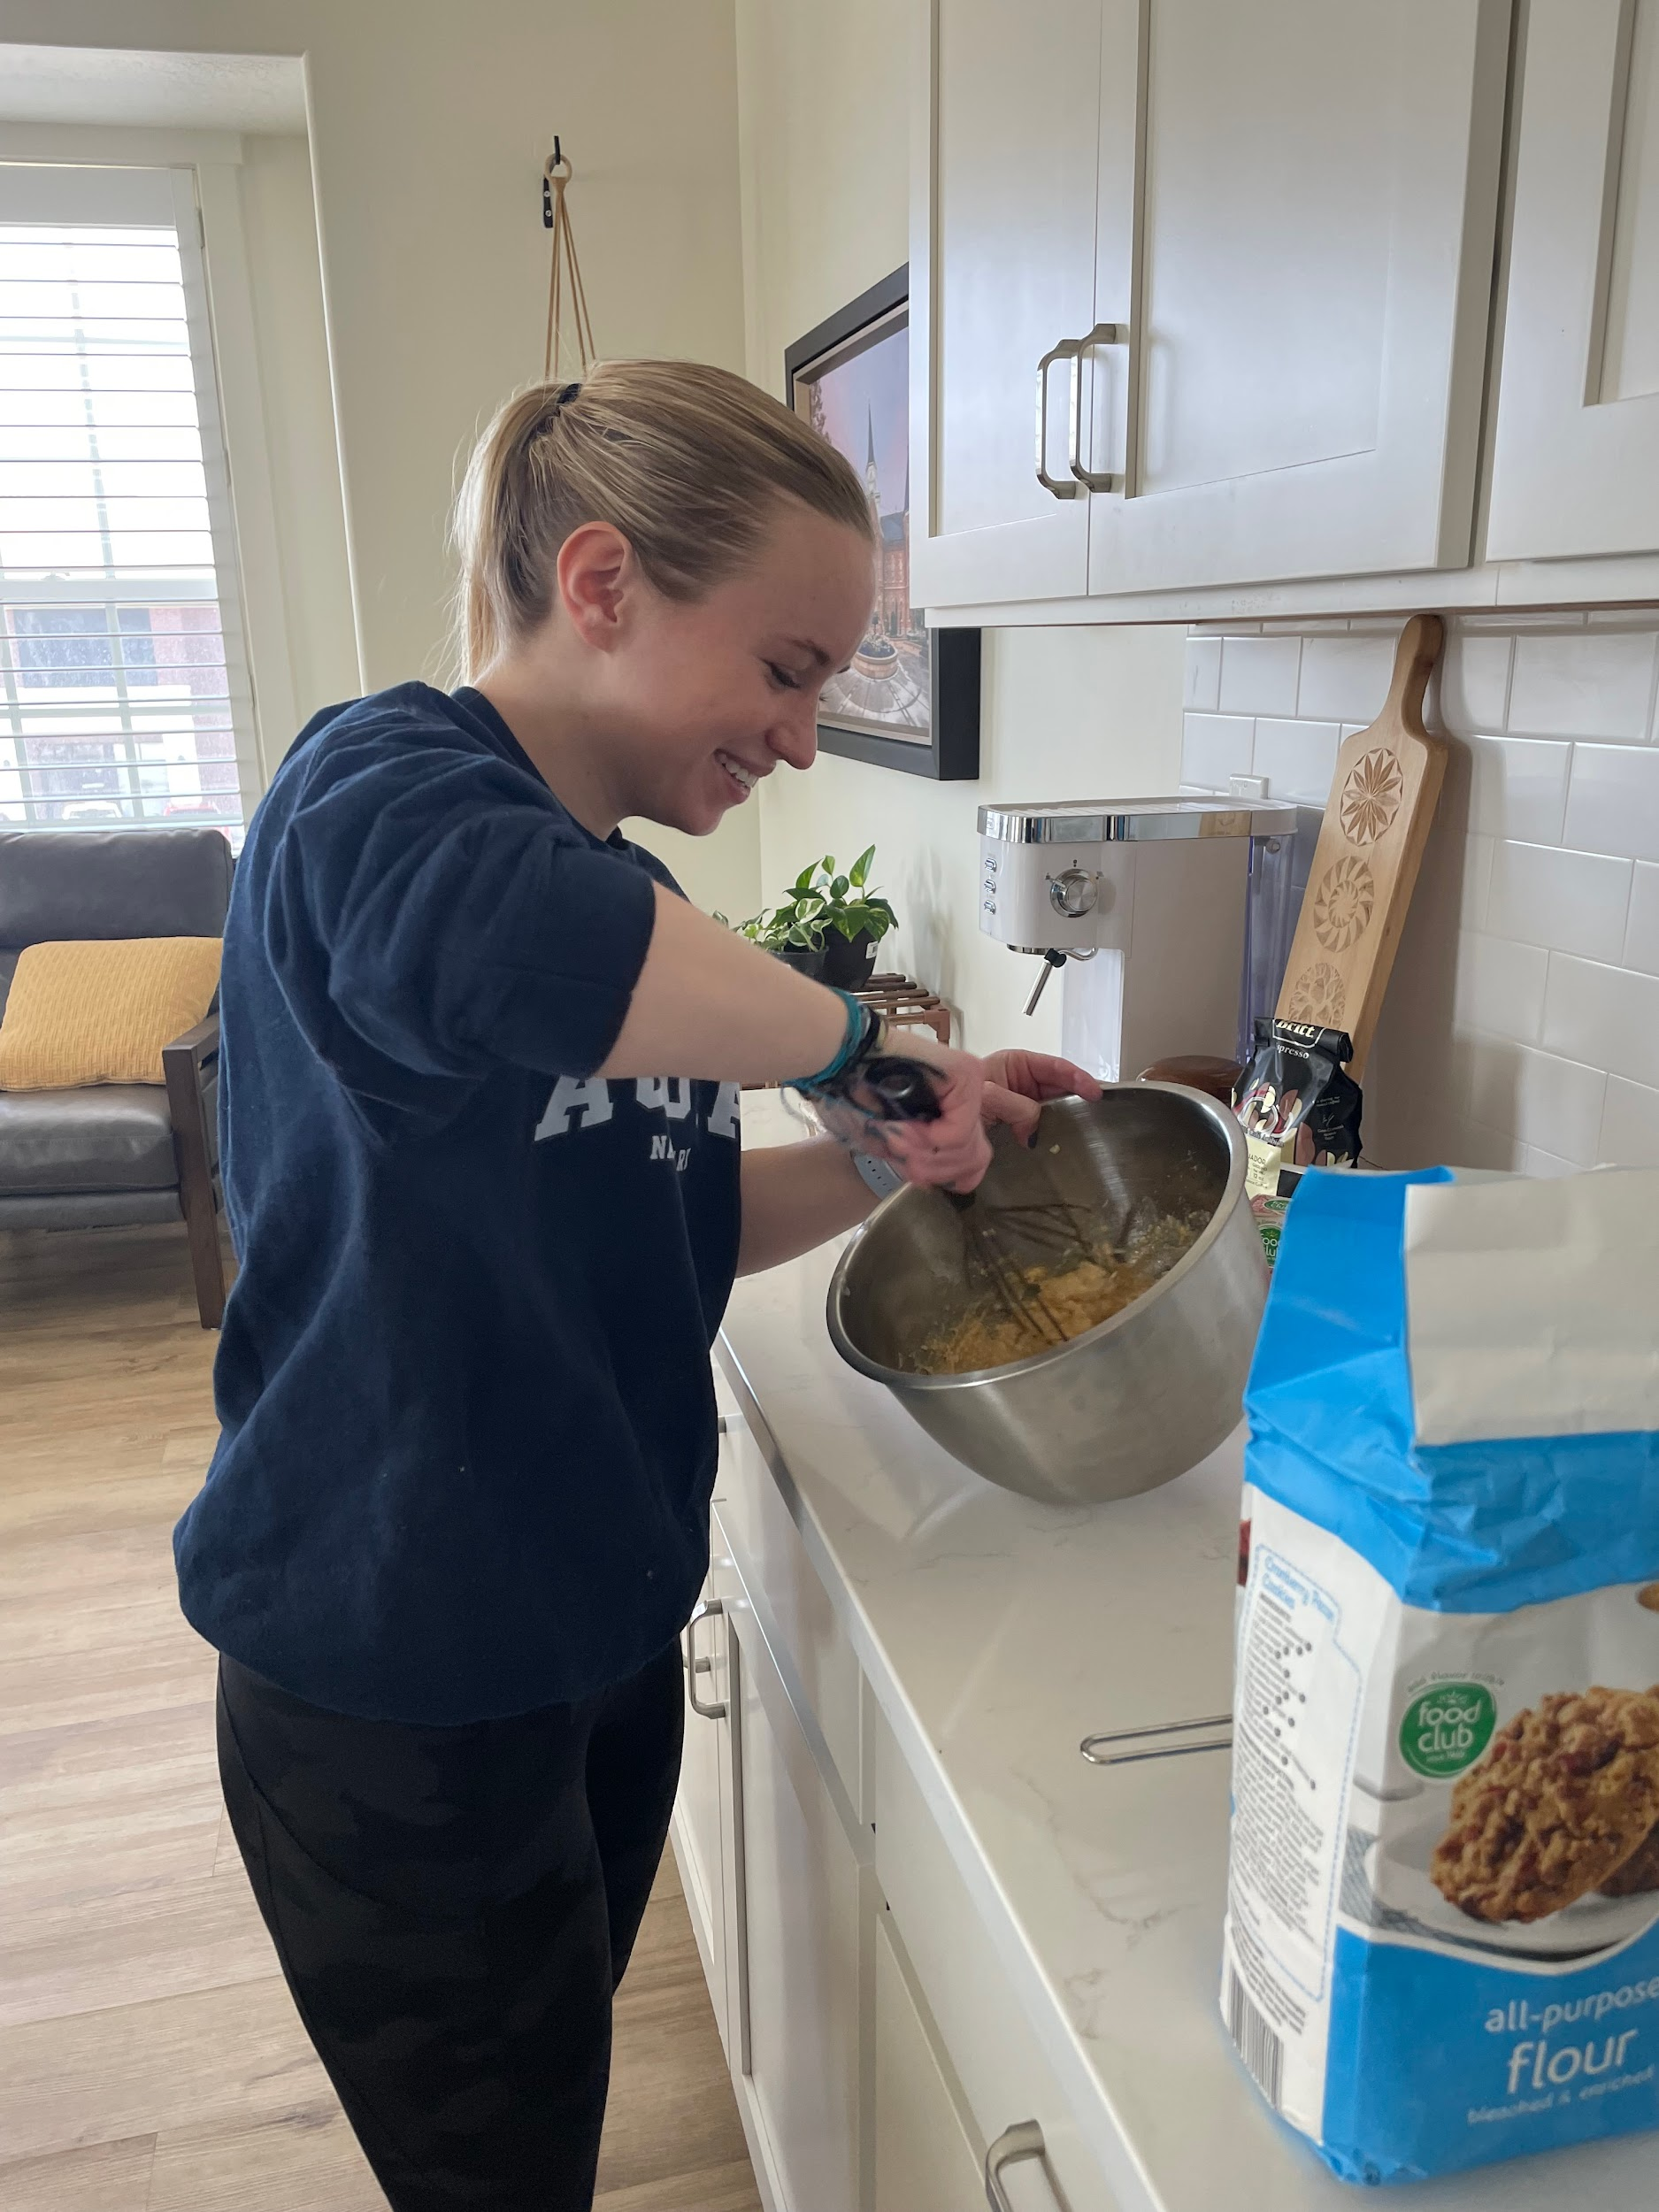
Experiment
Used the same recipe to make six different doughs for each of our treatments (randomized which dough received each ingredient)
Half the dough was chilled the night before
Measured each ball of dough to be .9 oz before we baked the cookies
Used the same oven, and each pan had 12 cookies (so each treatment had two batches in the oven)
Each batch was in the oven for 12 minutes
When all 24 cookies were made, we used a random number generator to choose 17 cookies
Notes:
S

Slide 9
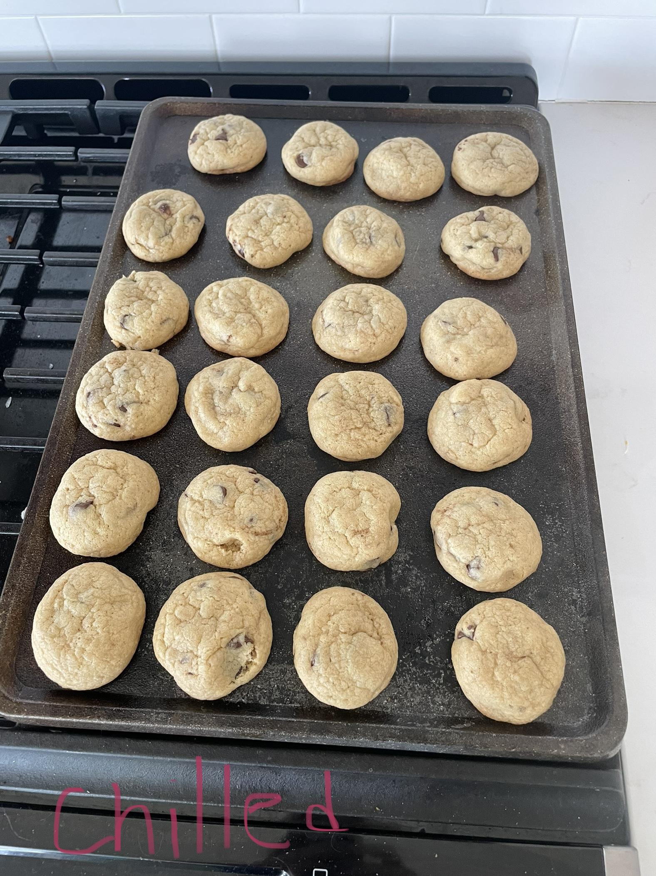
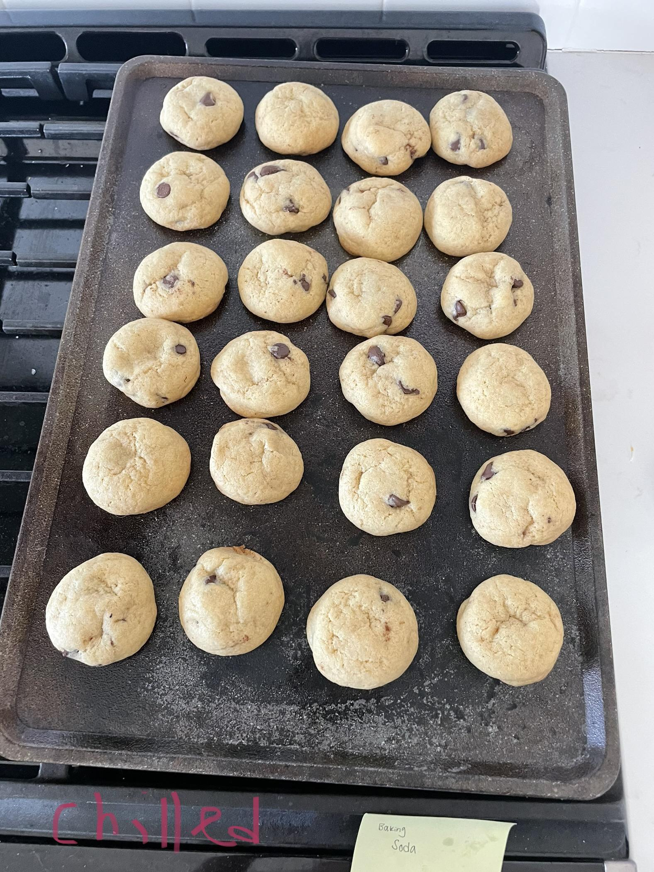
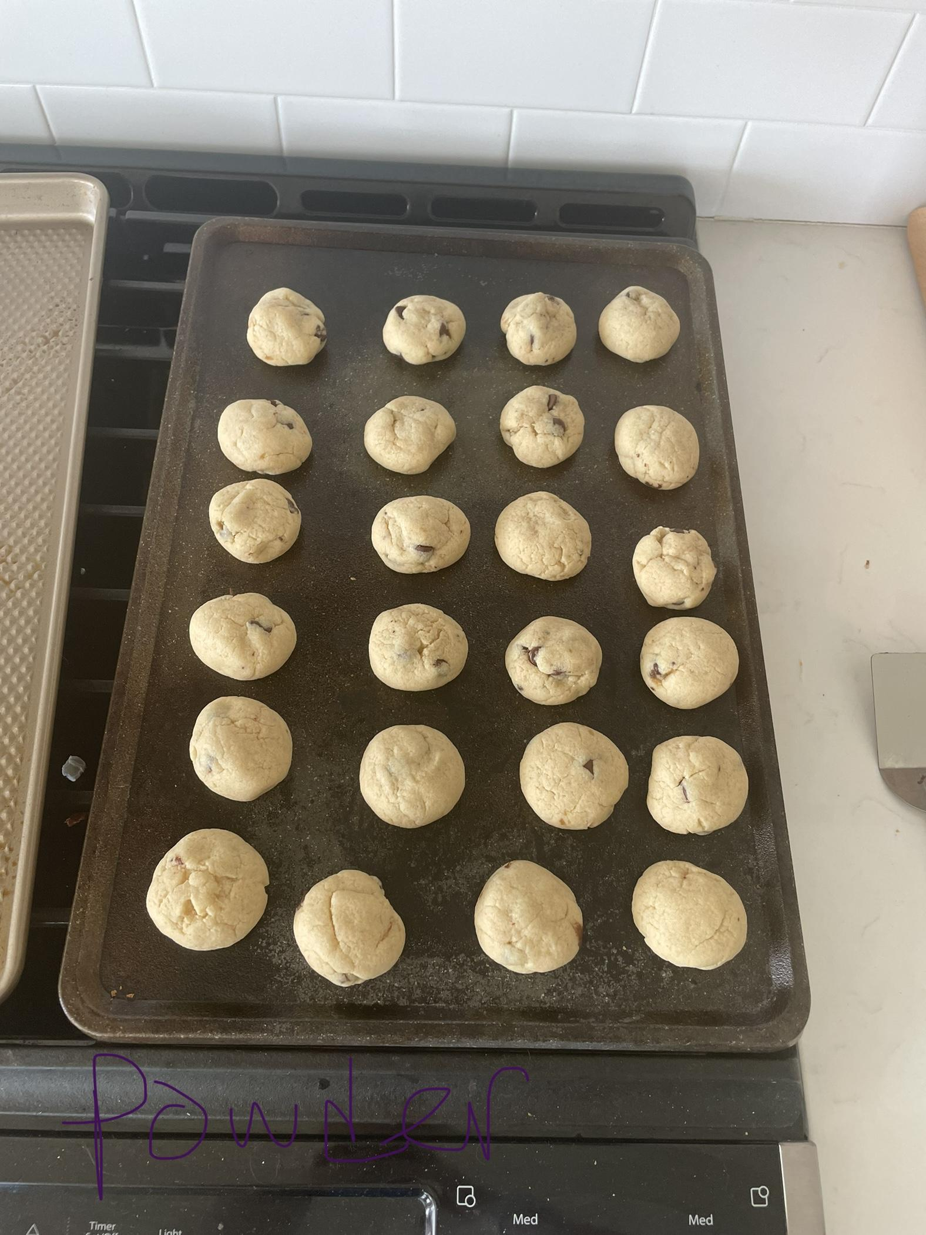
Picture Results
Chilled Mix Chilled Soda Room Temp Powder
Notes:
S

Slide 10
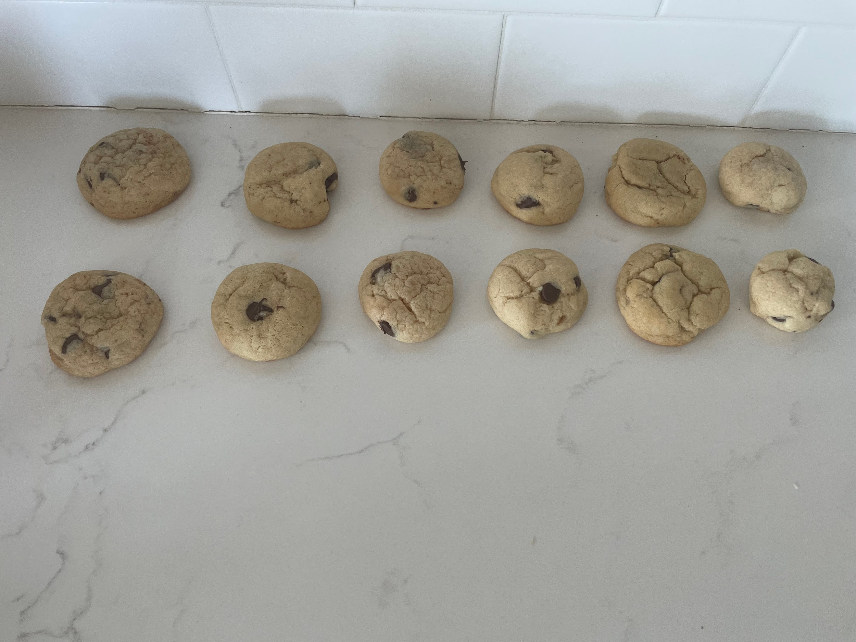
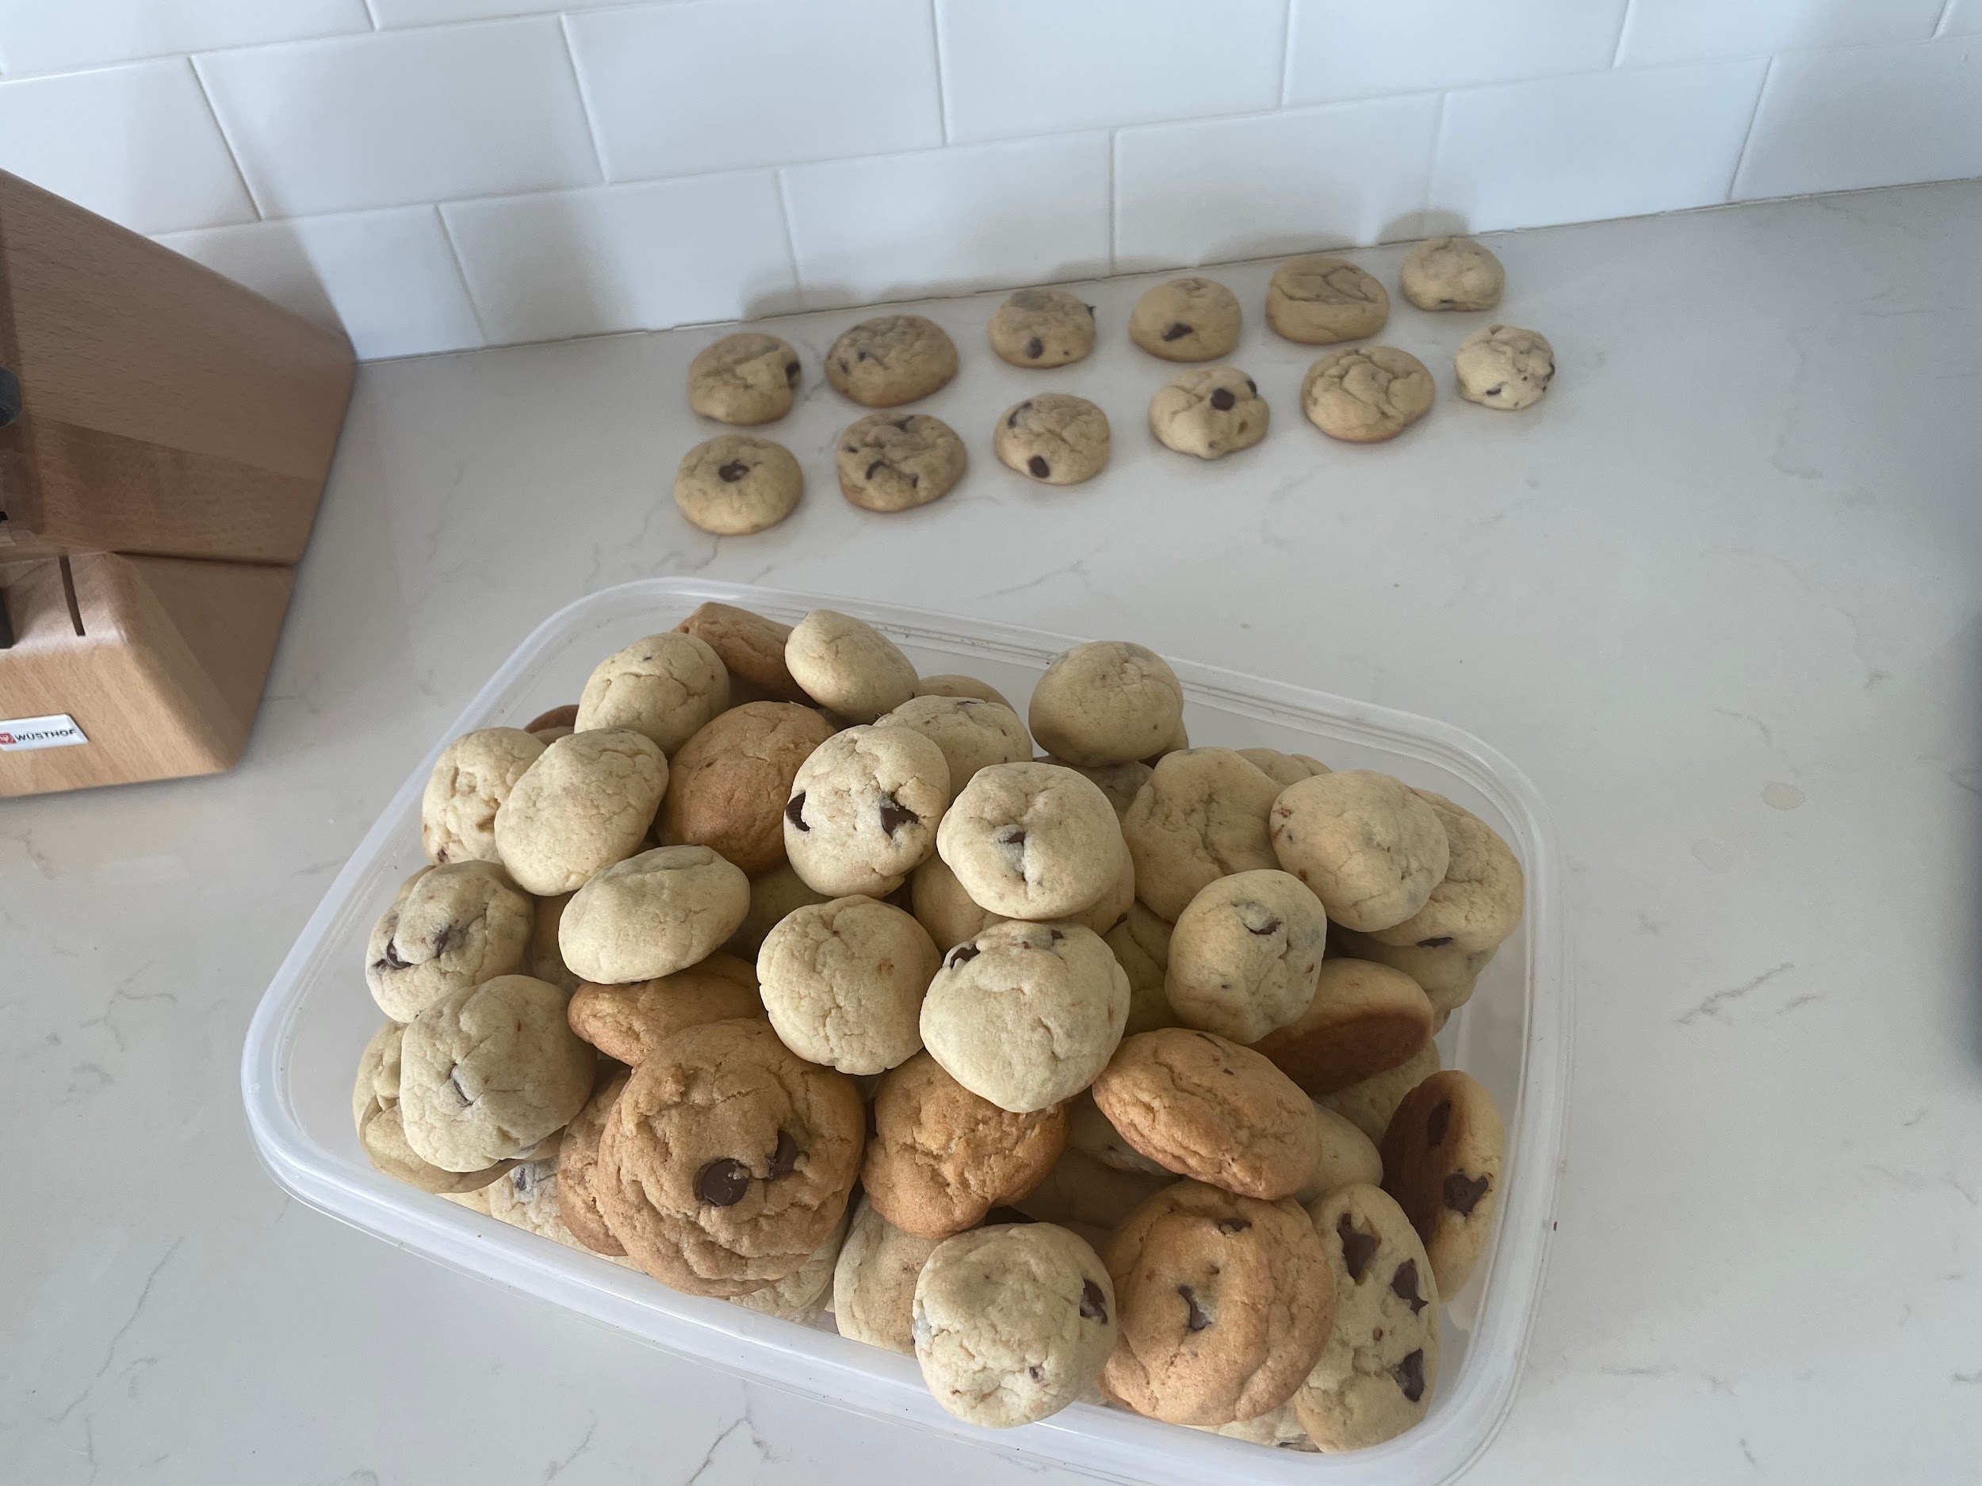
Each Treatment
Notes:
S

Slide 11
Data
size | temp | ingredient
6.5 | chill | mix
6.3 | chill | mix
6.3 | chill | mix
6 | chill | mix
6 | chill | mix
Link to full data:
https://docs.google.com/spreadsheets/d/1QZ2aPehTdkvEJQBNX9YtNLwxz_4vQaJ6HnuoSGDEVHY/edit?usp=sharing
Notes:
S

Slide 12
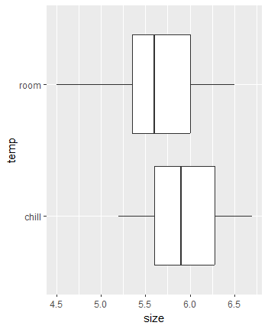
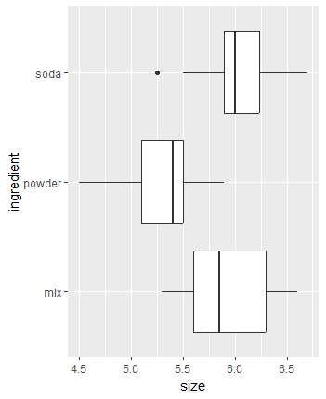
Boxplots
Notes:
Alyssa

Slide 13
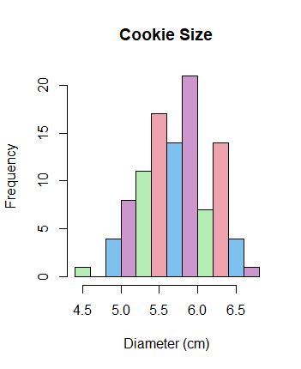
Histogram
Notes:
Alyssa

Slide 14
Anova Table - Sample Size 17
Response: size
Df Sum Sq Mean Sq F value Pr(>F)
ingredient 2 9.3683 4.6841 72.802 < 2.2e-16 ***
temp 1 2.1041 2.1041 32.703 1.213e-07 ***
ingredient:temp 2 2.3583 1.1791 18.326 1.814e-07 ***
Residuals 96 6.1768 0.0643
Notes:
Alyssa

Slide 15
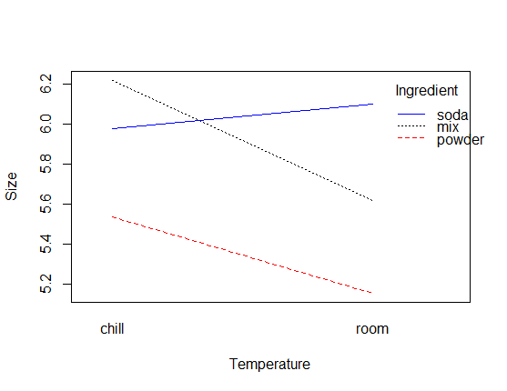
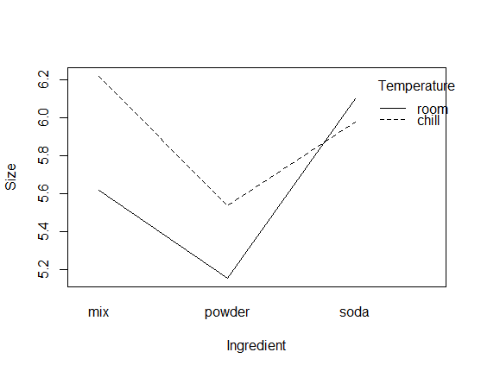
Interaction Plots
Notes:
Alyssa

Slide 16
Anova Table - Sample Size 6
Response: size
Df Sum Sq Mean Sq F value Pr(>F)
temp 1 0.12377 0.123773 1.7845 0.3133
ingredient 2 0.55108 0.275538 3.9725 0.2011
Residuals 2 0.13872 0.069361
Notes:
Alyssa

Slide 17
Post Power Testing
Our preliminary testing overestimated each group mean and variance, so our power ended up being closer to 99% for sample size 17
With only one sample for each treatment (six samples), we would not reach our goal of 80% power
Notes:
Alyssa

Slide 18
Effect Sizes (in cm)
Grand Mean = 5.767157
Room Temp = + 0.1436271
Chilled = - 0.1436271
Mix = + 0.1519611
Baking Soda = -0.4230389
Baking Powder = + 0.2710781
Notes:
B

Slide 19
Difference of Means
Chilled vs. Room Temperature t = 0.7712496 p value = 0.2377041
Mix vs. Soda t = -0.3198167 p value = 0.6189805
Soda vs. Powder t = 1.863631 p value = 0.06070145
Powder vs. Mix t = 1.543815 p value = 0.09164238
Notes:
B

Slide 20
Error and Bias
If we were to do this experiment again, we would perform more replication to determine if there is significant evidence
Another source of error could be measuring ingredients, although we tried our best to be precise, there could’ve been variability between each dough.

Slide 21
Conclusion
When we used a sample size of 17, we obtained significant results for temperature, ingredient, and the interaction between the two.
However, we learned of our mistake in randomization after we had obtained the data.
With six samples total, we would not reach our goal of 80% power and the results were not significant
We cannot conclude that there is a significant difference in the diameter of chocolate chip cookies when using the different temperatures or ingredients tested.
Notes:
B

Slide 22

Questions?
Notes:
B

